Slide 1
DATABASE PROJECT
MINI FACEBOOK
BY
Shubh johri
Sameer Rajput
Divya puraswani

Slide 2
OVERVIEW
The purpose of the project is to create a platform where people/users can create profile, make friends, post statuses, upload photos and comment.
Aim of this project is to understand and create a relational database from designing to its implementation phase; and run queries using MySQL.

Slide 3
technology USED
Database – MySQL
Web Application (For querying) – phpMyAdmin
Data Visualization - Tableau
Web Server used - XAMPP
Code Standard - HTML, PHP

Slide 4
Business Objective
Allow users to view, upload and comment on posts.
Provide friend recommendations to the users.
Allow users to view the mutual friends and friends of friends.
Notify the users about their friends’ birthdays and anniversaries.

Slide 5
Business Rules
A user can have zero to many friends and a friend belongs to a single user.
A user can have zero to many posts and one post can be posted only by a single user.
A post can either be a status or a wall message, and both the status and wall message can be in the form of either text or a photo.
A post contains zero to many photos and a photo is contained in a unique post.
A post can have multiple comments and a comment is unique to a post.

Slide 6
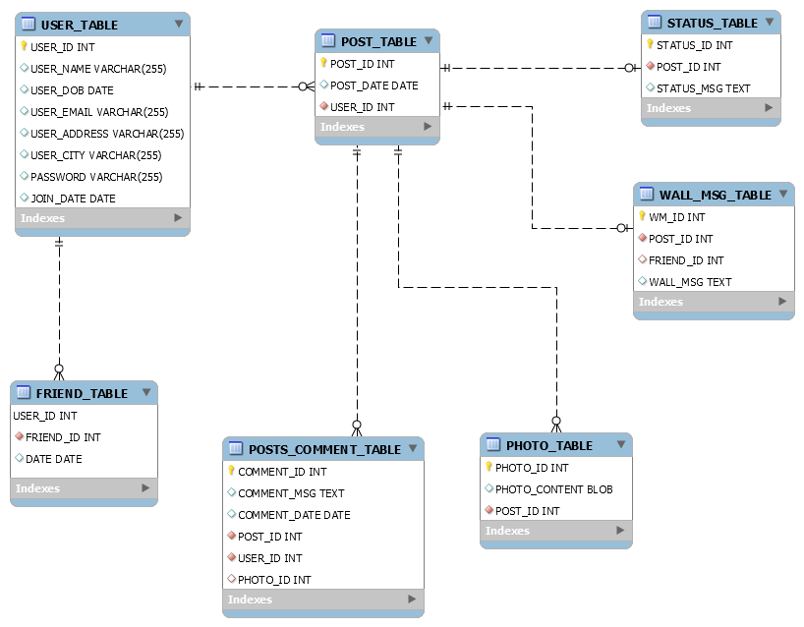
DATABASE DESIGN-ER DIAGRAM

Slide 7
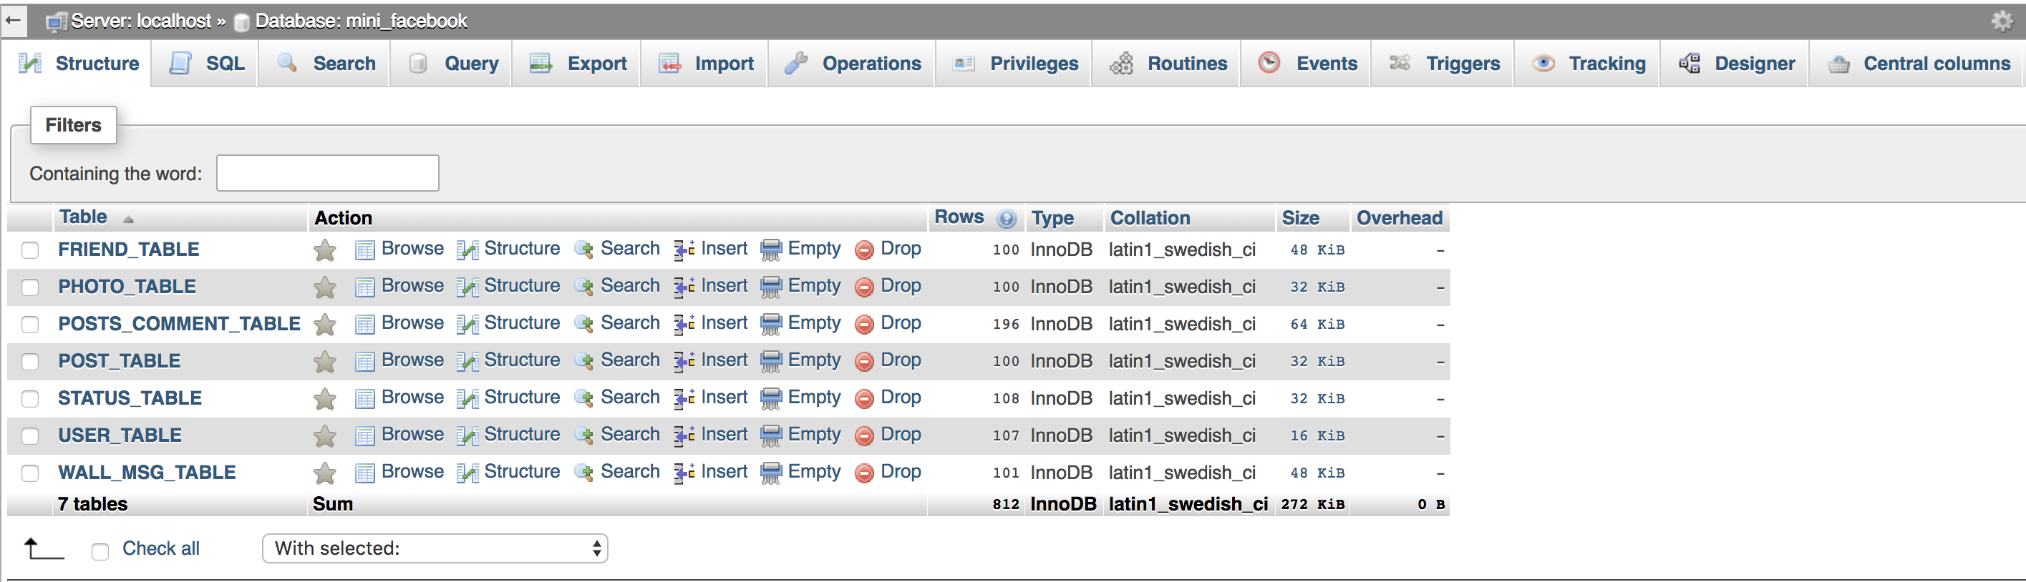
STRUCTURE OF DATABASE-TABLES

Slide 8
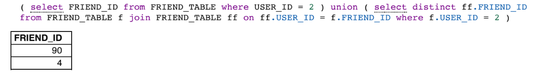
QUERY 1- FRIENDS AND FRIENDS OF FRIENDS

Slide 9
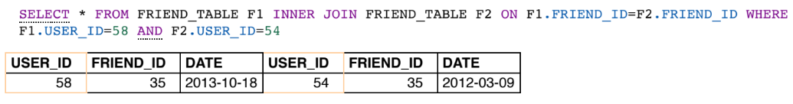
QUERY 2-MUTUAL FRIENDS

Slide 10
DEMO-UI AND DATABASE QUERIES
User interface showing log in for existing user, sign up for new user and navigating to other pages for posts etc.
http://localhost/project/Facebook.php
Link to phpmyadmin
http://localhost/phpmyadmin/db_structure.php?server=1&db=mini_facebook

Slide 11
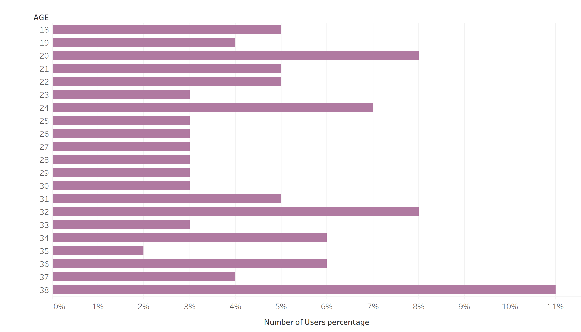
BUSINESS INSIGHTS FROM DATA
On the basis of User’s Date of birth deriving and depicting age groups of people using Mini-Facebook

Slide 12
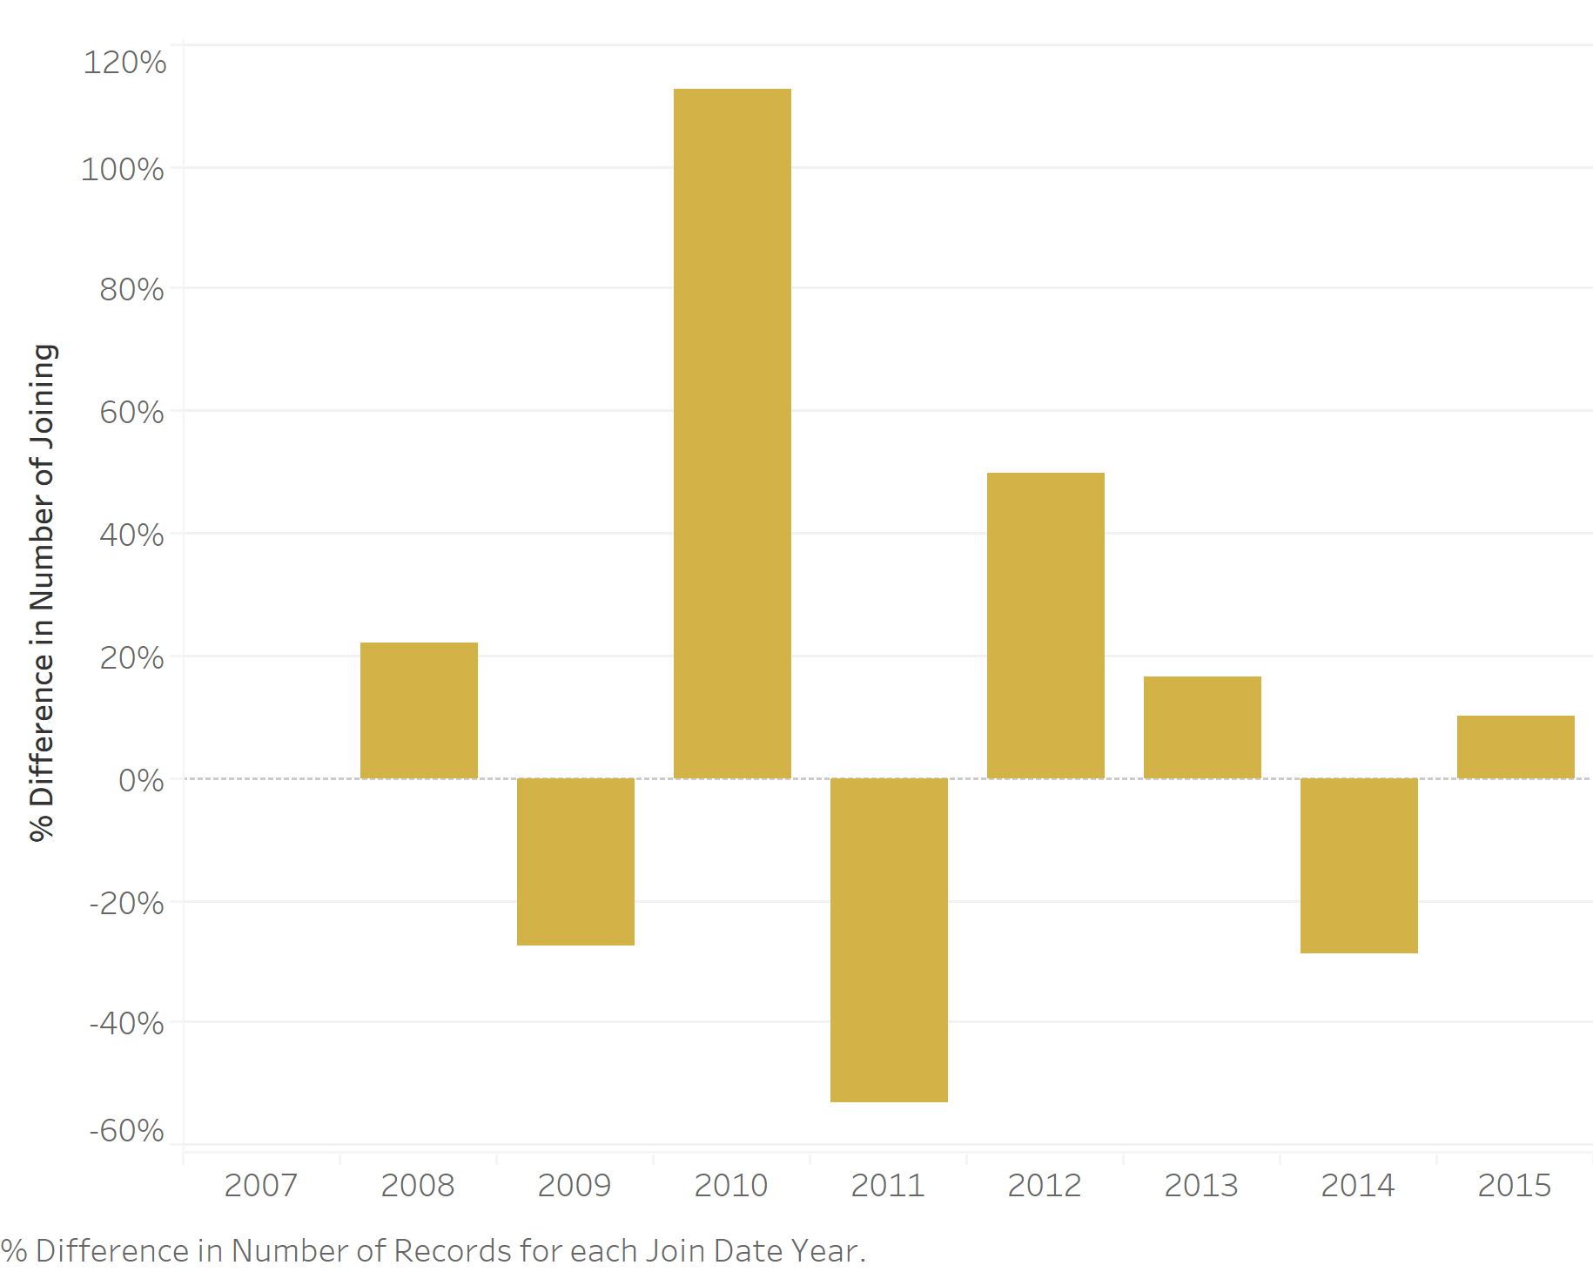
BUSINESS INSIGHTS FROM DATA
On the basis of Joining date deriving and depicting number of people who joined Mini-Facebook

Slide 13
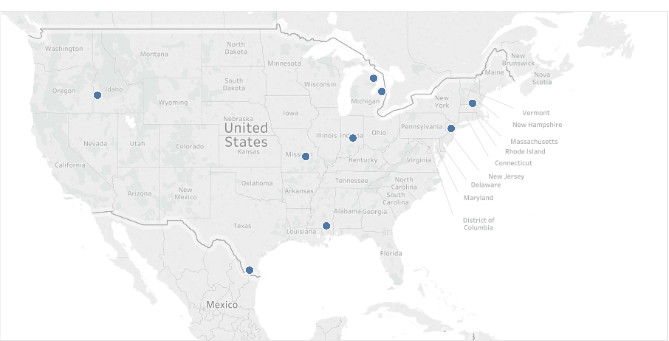
BUSINESS INSIGHTS FROM DATA
Majority of users concentrated in US

Slide 14
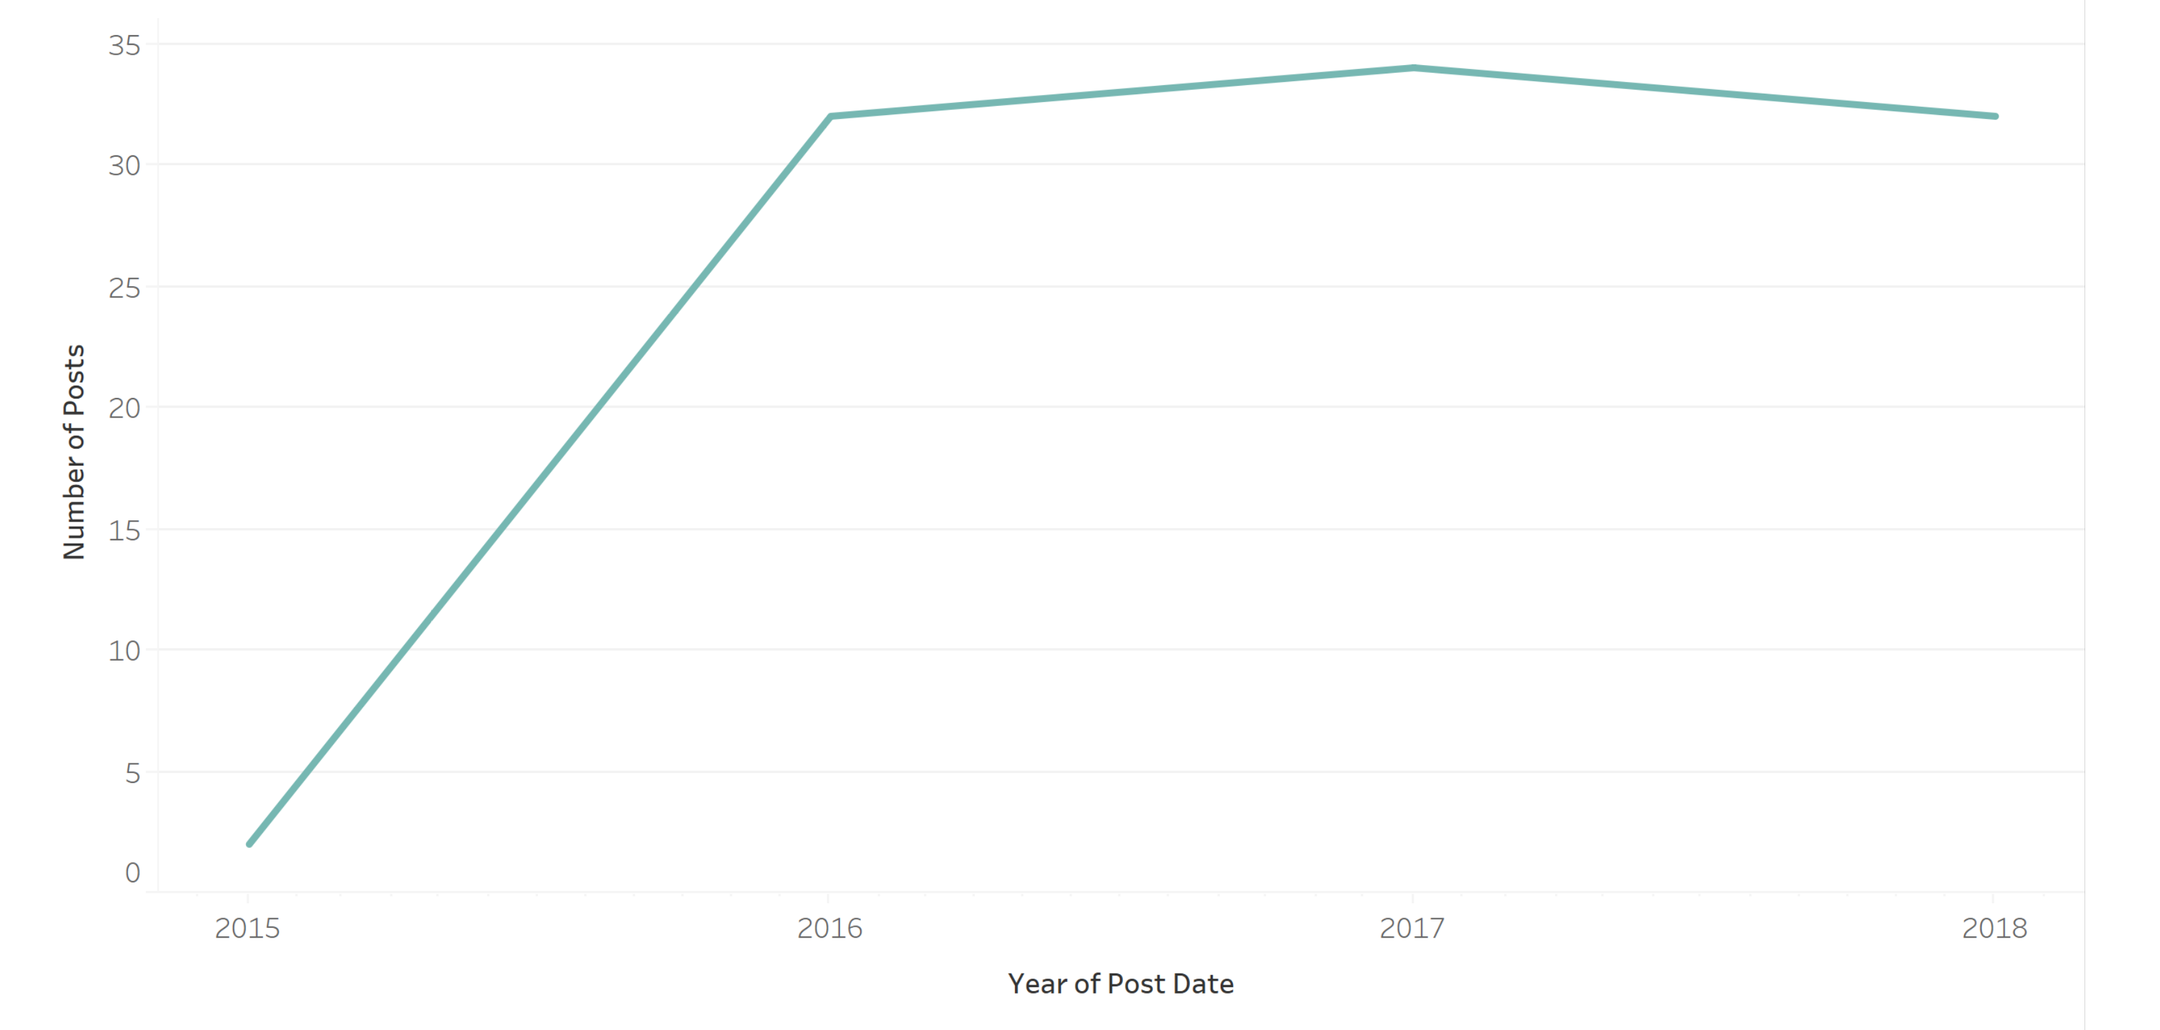
BUSINESS INSIGHTS FROM DATA
On the basis of posts depicting number of posts by users who joined Mini-Facebook

Slide 15
CONCLUSION
Mini Facebook covers all the basic features of any social networking database.
User interface which we provided is simple and user friendly.
This database project, fulfilled our objective of learning MySQL and implementing queries to create user information, uploading status, finding friends of friends etc.

Slide 16
FUTURE WORK
We can further implement some features like-
Better interface for the website using AJAX,Javascript
Using database like MongoDB or Graph databases
Alert emails or notifications

Slide 17
QUESTIONs AND ANSWERS ? THANK You!

